Slide 1

Cultural Adaptation
Culture Shock, Adaptation Stages and Tips

Slide 2

Culture Shock
Feeling isolated while living abroad for an extended period of time
Being cut off from one’s culture, family, language
Having one’s values, traditions, routines in question
Being expected to be highly functional within a foreign environment

Slide 3

Some Symptoms
Homesickness
Withdrawal
Sadness/crying
Family conflict
Inability to concentrate
Too much/little sleep
Too much/little eating/drinking
Anger/irritability
Illness

Slide 4
Cultural Variations
Body language
Courtship practices
Perceptions of beauty
Hierarchy & leadership
Cleanliness & hygiene
Concepts of fairness

Slide 5
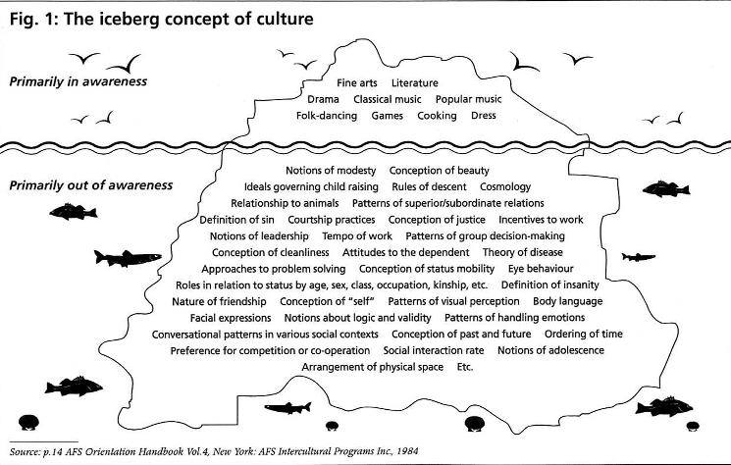
The Iceberg Concept of Culture

Slide 6


CHANGE
TIME
EQUALITY
INDIVIDUAL
INITIATIVE
FUTURE
INFORMALITY
DIRECTNESS
RULES
TRADITION
HUMAN INTERACTION
RANK
GROUP
INHERITANCE
PAST
FORMALITY
INDIRECTNESS
NEGOTIATION
Adapted from “The Values Americans Live By” by L. Robert Kohls

Slide 7
Ask your neighbor…
Have you experienced culture shock before?
What is one way you’ve been surprised since arriving in the US?
How do you think your experience of those ‘surprises’ might evolve over time?

Slide 8
4 Stages of cultural adaptation
Stage 1: FUN AND EXCITEMENT stage 2: IRRITATION AND hostility stage 3: gradual adjustment stage 4: adaptation AND BICULTURALISM
Source: Window on the World, Inc.

Slide 9

Stage 1: Fun and Excitement
The “honeymoon” period
Relief that you are finally here
Great expectations
Everything is new, fascinating, intriguing, exciting
Focus is on how we are all alike

Slide 10

Stage 2: Irritation and Hostility
Focus changes from similarities to differences
Differences are frustrating
Students may feel inadequate and unproductive
Little difficulties become major problems
Reality sets in

Slide 11

Stage 3: Gradual Adjustment
Have adopted some of the local values and customs
Feel less isolated
Increase in self confidence
Gradually learning to function
well under new conditions

Slide 12

Stage 4: Adaptation and Biculturalism
Increased enjoyment of
new context
Ability to function in two
cultures with confidence
Feeling that life may be just
as good or better than before
Realization that there will be things you will miss when you leave

Slide 13

Key Challenges
Formal vs. informal writing
Understanding instructions
Communicating with faculty and classmates
Participating in group/classroom discussions
Managing coursework load

Slide 14
Keys to Cultural Adjustment
Participate in social activities
Create new support systems
Take care of yourself
Improve your language skills
Experiment, expand and explore

Slide 15
General Tips
Use Google and the RSPH website to find info
Use Wikipedia only to find other sources
Look ahead and make appointments in advance
RSVP and don’t be a “no show”
Don’t be offended by government or other officials (i.e. the DMV)
Talk to a counselor
Make new friends
Be kind to yourself, manage your expectations and remember you’re not alone!
Give yourself a break and
manage your expectations!

Slide 16

“Just when the caterpillar
thought the world was over,
she became a butterfly.”
― Barbara Haines Howett, Ladies of the Borobudur

Slide 17
Your RSPH Student/Alumni panelISts:
Shreya Kothari
Joyce Beyamu
Bishan Huang
Jiabei He
Got questions? Ask the experts!

