Slide 1
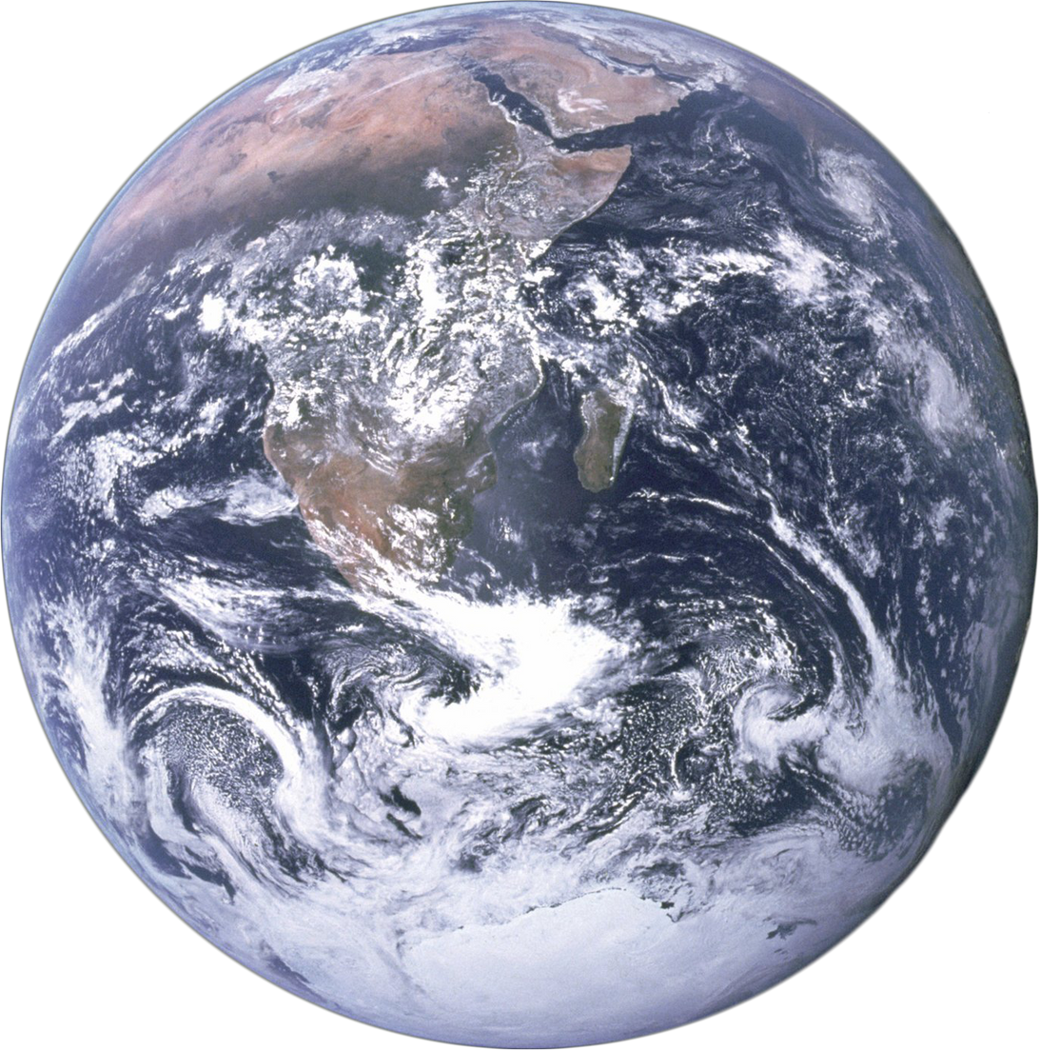

Thursday, January 16, 2025
GLOBAL FIELD EXPERIENCE (GFE) FINANCIAL AWARD
INFO SESSION
Notes:
Opening

Slide 2
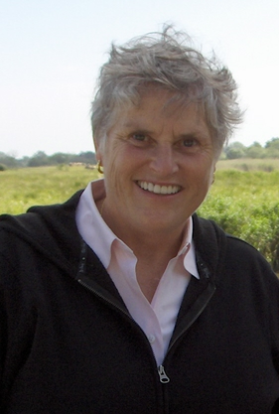
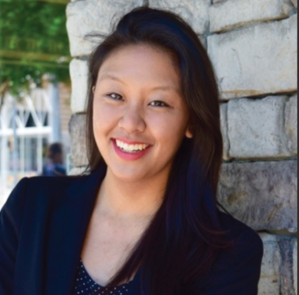
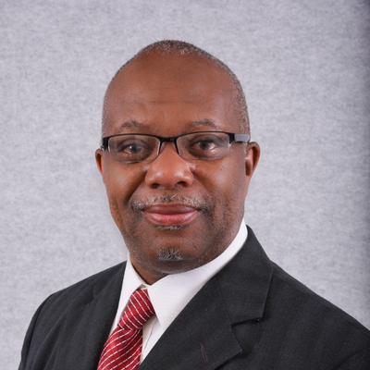
Your GFE Financial Award Support Team
Dr. Deborah McFarland
Hubert Department of Global Health
Director/Faculty Contact
Joanne Williams
Professional Advancement & Student Experience Center
Executive Director
Gerald Clay
Professional Advancement & Student Experience Center
Associate Director/GFE Financial Award Coordinator
Notes:
Gerald

Slide 3
WHAT IS THE GLOBAL FIELD EXPERIENCE (GFE) FINANCIAL AWARD PROGRAM?
History & Purpose: The awards program started around 1995 to encourage students interested in global health to participate in supervised field training which will facilitate the transfer of classroom knowledge into practice experiences.
  It is administered by one staff member and a faculty review committee chaired by Dr.McFarland.
Important Note:
    This is a supplemental funding source that ranges between $2500 and $4500.
    The awards are funded by designated endowments and how much we can award each year depends upon financial returns.
Notes:
Gerald

Slide 4
Philip S. Brachman, Sr.,
William and Paula Foege,
Dorothy and Stanley O. Foster,
Eugene J. and Rose Salamone Gangarosa,
Richard and Linda Hubert and the Hubert Foundation,
Carol and Carlos Martel,
Deborah A McFarland,
Don E. and Kathleen Sokolik
AWARDS MADE POSSIBLE BY:
Notes:
Gerald

Slide 5
HOW CAN I QUALIFY FOR THE
GFE FINANCIAL AWARD?
Qualifications: To qualify for the financial award, the student must have:
  Secured a 6-12 week summer fieldwork opportunity that benefits the populations of LMIC or priority populations in the US as identified by the CDC Office of Minority Health & Health Equity.
  Identified a faculty guide who will offer guidance for your experience.
  Enrolled in courses for Fall 2025.
  After securing an opportunity, completed the GFE Application by the designated due date in the Spring Semester.
Tip:
Start looking for opportunities now by working your network, exploring 12Twenty, and reaching out to Faculty Members.
Notes:
Gerald

Slide 6
CAN MY GFE PROJECT COUNT AS AN APPLIED PRACTICE EXPERIENCE?
The opportunity that you secure may count as Applied Practice Experiences (APE) if they meet your department APE requirements.
  If you are unsure if a position that you are interested in meets those requirements, contact your ADAP or departmental APE advisor.
  If you are enrolled in a certificate, please check with your certificate coordinator for additional APE requirements.
Notes:
Gerald

Slide 7
APPLICATION PROCESS
1
2
3
4
5
REFLECT
EXPLORE
PLAN
CONSULT
APPLY
Notes:
Joanne

Slide 8
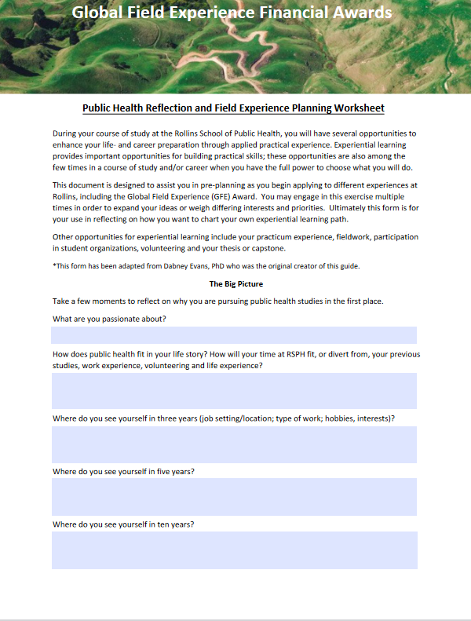
APPLICATION PROCESS
1
REFLECT
2
3
4
5
Reflect on why you are pursuing public health. How will you prioritize what is most important to you about a summer experience: setting, population, topic or skills?
Tool: Use our worksheet on website to facilitate reflection.
EXPLORE
PLAN
CONSULT
APPLY
Notes:
Joanne

Slide 9
APPLICATION PROCESS
2
Tip:
You can complete this step now! To qualify for GFE, we recommend securing an opportunity by mid-February, at the latest.
EXPLORE
1
3
4
5
You are responsible for securing an opportunity and a faculty guide to qualify for the GFE Program:
Work your network: Talk to faculty, second-years, and guest speakers.
Explore 12Twenty- Use “global field experience financial award eligible” filter
Search past projects on the GFE Website
NOTE: Not all projects qualify for GFE. Exclusions include third-party public health tourism, medical/clinical shadowing or work in a lab or with data sets with no clear reason why global setting is relevant.
REFLECT
PLAN
CONSULT
APPLY
Notes:
Joanne

Slide 10
APPLICATION PROCESS
3
Tip:
These questions are on the GFE Application. Remember, give yourself at least two weeks to complete the application after securing an opportunity.
PLAN
1
2
After securing an opportunity, identify and connect with your faculty guide and field supervisor early and often to discuss the scope of your fieldwork experience & prepare for your application.
What are my career goals?
What is the background of the work that I will be doing?
What are the objectives my project?
What methods will I use?
What is the timeline of my project? Is it feasible?
What are the deliverables that I will provide to the organization?
What is my Plan B, in case I am unable to complete this opportunity as originally planned?
4
5
REFLECT
EXPLORE
CONSULT
APPLY
Notes:
Joanne

Slide 11
APPLICATION PROCESS
4
Tip:
These questions are on the GFE Application. Remember, give yourself at least two weeks to complete the application after securing an opportunity.
CONSULT
1
2
3
5
As you work with your faculty guide and field supervisor, be sure to ask lots of questions and receive feedback with humility. Other items that you should consider when applying are:
What do I need to do to prepare for travel?
What are the language requirements?
What is my budget when pursuing this experience?
What resources do I have available to ensure that I and the communities I serve are safe? How can I mitigate or manage risk?
What contribution or support is my field supervisor / host organization providing, if any?
REFLECT
EXPLORE
PLAN
APPLY
Notes:
Joanne

Slide 12
APPLICATION PROCESS
5
Tip:
The GFE application requires some time to complete. We anticipate that the application will be due by February 28
APPLY
1
2
3
4
Develop your application in a word processing app first; it must be submitted all in one sitting.
Include draft tools/materials as uploads, indicating you will revise in- country or in practice with local input.
Give your faculty guide ample time to complete the Faculty Guide Approval Form.
REFLECT
EXPLORE
PLAN
CONSULT
Notes:
Joanne

Slide 13
OTHER IMPORTANT QUESTIONS FOR YOUR FIELD SUPERVISOR AND FACULTY GUIDE
  Be sure to have a contact that you work with throughout project development
  They must contribute towards both your project AND supervision during the program.
  Communicate in advance on site-specific project components:
    Seasonal changes
    Religious holidays
    Populations at risk
    Personal and beneficiary risk mitigation
    Confidentiality of data
  Be sure that your project contributes to the needs of the organization and that this is documented in application.
    Are they able to provide any in-kind support such as subsidizing accommodations
    Do they provide ground transportation
    Do they cover the cost of translators or research participant incentives.
    Be prepared for the answer to be “no”.
  Ask whether local/national IRB is required.
    If so, it will often take a long time.
    Start early and discuss ASAP with your advisors.
    Remember: Global experiences are often self-driven and require you to communicate or ask questions.
Notes:
Joanne

Slide 14

THE BOTTOM LINE
IS THIS A MEANINGFUL, RIGOROUS, ETHICAL PROJECT, RESPONSIVE TO COMMUNITY NEEDS, AND CAN IT BE DONE IN THE TIMEFRAME?
Notes:
Deb

Slide 15
I RECEIVED THE AWARD!
WHAT HAPPENS NEXT?
COMPLETION OF AN ASYNCHRONOUS, PREDEPARTURE TRAINING COURSE IS REQUIRED
FOR ALL GFEFA RECIPIENTS AND ANY STUDENT TRAVELING FOR SUMMER FIELDWORK
Objectives:
  Demonstrate humility while engaging in fieldwork.
  Identify, mitigate, address, and report potential security risks that may occur while traveling or during fieldwork.
  Document compliance with school / program expectations regarding travel safety.
  Engage in safe, meaningful, fieldwork with global communities.
Topics Include:
  Ethics and Cultural Humility
  Travel and Safety, including engaging with International SOS (ISOS)
  Health, Wellness, and Immunizations
IMPORTANT:
All students are required to follow Emory University International Travel Policies:
  All international travel must be booked through the Emory University travel agency: Sequel Travel
  All international travelers are covered by ISOS when travel booked through Emory travel
  You should be prepared for changes in your international travel plans.
Notes:
Joanne

Slide 16
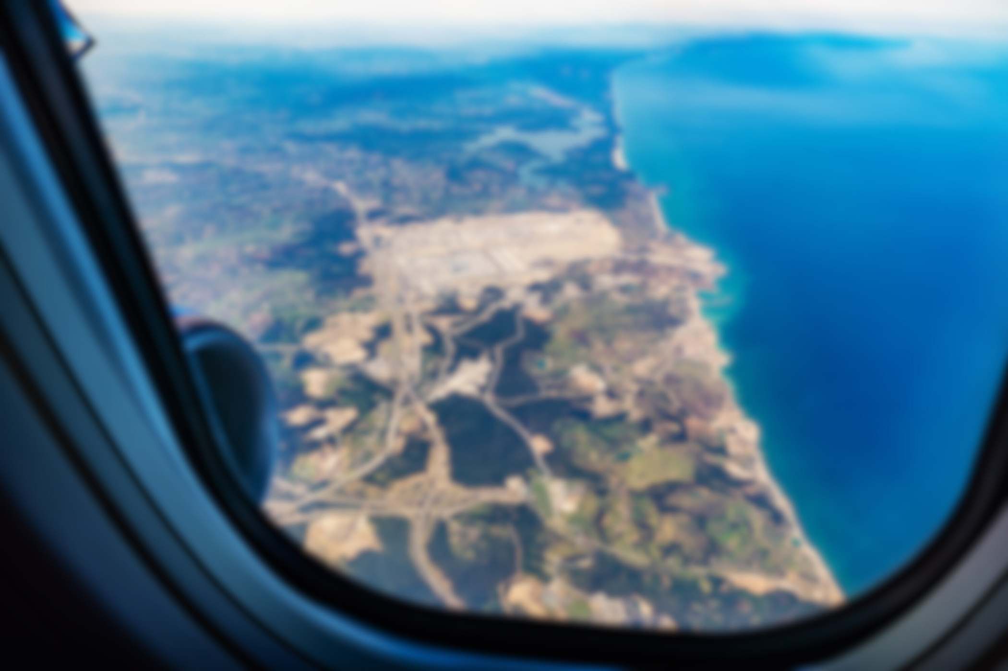
WHEN YOU RETURN YOU WILL BE REQUIRED TO PARTICIPATE IN DEBRIEFING EVENTS AND PROVIDE A SUMMARY AND PHOTO FROM YOUR PROJECT
UPON RETURN
Notes:
Gerald

Slide 17
Advice from Dr. McFarland
Dr. Deborah McFarland
Faculty Contact and GFE Financial Award Donor
Notes:
Deb

Slide 18
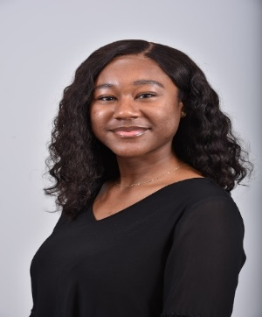
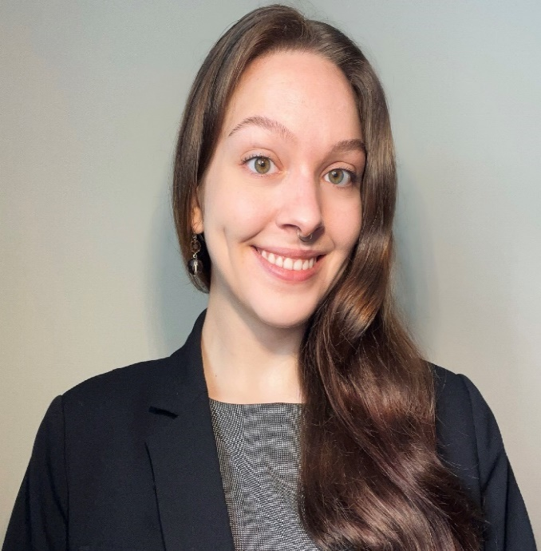
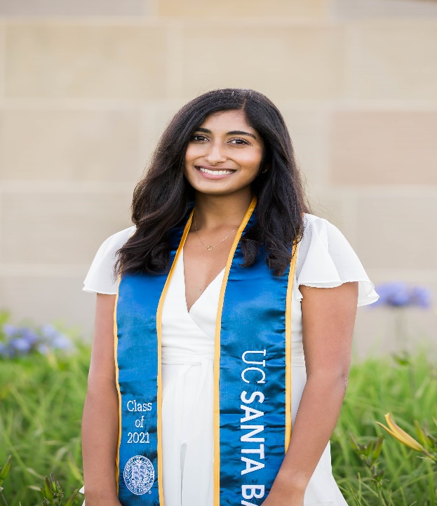
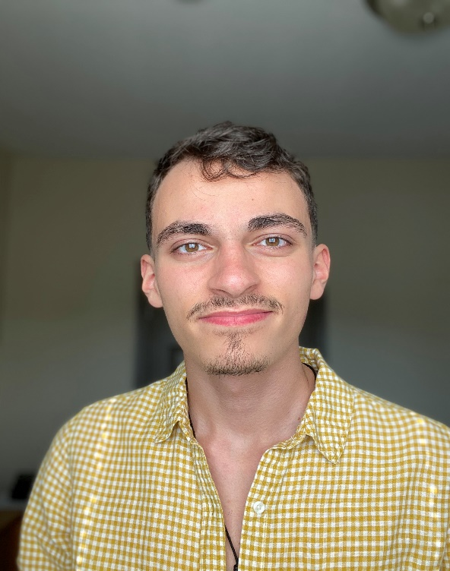
Student Panel
Leslie Owusu
GEH ‘25
Project completed in Ethiopia
Alia Bly
EPI ‘25
Project Completed in Ethiopia
Aditi Satyavrath
GH ‘25
Project Completed in India
Santino Diaz-Palma
EPI ‘25
Project Completed in Brazil
Notes:
Gerald

Slide 19
ADVICE FROM PREVIOUS STUDENTS
Make sure you know appropriate work clothing for the culture you're entering | It’s really helpful to talk to and ask questions of students and faculty who have spent time in the area you’re traveling to | Be realistic about what you can accomplish in a summer | Make copies of your passport
Prepare for jetlag | Be sure to budget for other trips | Plan, plan, plan for everything and anything | Have a back-up summer APE because it can all fall apart in April
Have the thesis project discussion early if you plan to use your APE for your thesis | If there are red flags about the project, believe them | Plan a budget and STICK TO IT. Give yourself some wiggle room, too. Your budget is not going to be 100% accurate | Don’t expect everything to go as planned

Slide 20
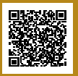
The Application opens on 1/14/25
The Application closes on 3/14/25
QUESTIONS?
Email gferequests@emory.edu for additional specific questions
Notes:
Gerald

